Slide 1
3. Building environments for digital forensics

Slide 2
Topics
Forensic Laboratories
Policies and Procedures
Quality Assurance
Hardware and Software
Accreditation v. Certification

Slide 3
Forensic Laboratories

Slide 4
Forensic Labs
Most are run by law enforcement agencies
FBI's crime lab in Quantico, VA is largest in the world
Regional Computer Forensic Laboratory (RCFL)
  FBI Program
  16 facilities throughout US
  They process smartphones, hard drives, GPS units, and flash drives

Slide 5

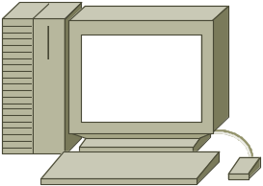
Virtual Labs
Drive images on server
Evidence repository separate from the examiner
This is how the FBI does it
Saves money, increases access to resources
Role-based access
  Examiners and management get full access
  Investigators, prosecutors, and attorneys get restricted access
Examiner
connects remotely

Slide 6
Concerns with Virtual Labs
Security
  Must retain integrity or evidence will be inadmissible in court
Performance
  High-speed connectivity required
Cost

Slide 7
Lab Security
Physical security
  Keep unauthorized people out of critical areas
    Examination stations
    Evidence storage
  Keys, swipe cards, access codes
  Digital access control is better than keys
    Keeps an audit trail to support chain of custody
  Protection from fire, flood. etc.

Slide 8
Chain of Custody
Evidence must be signed in and out of storage
Evidence log must be complete

Slide 9
Work in Isolation
Forensic examination computer should not be connected to the Internet
This avoids arguments over contamination by malware
Evidence drives may contain malware
  Scan them with antivirus software

Slide 10
Evidence Storage
Data safe
  Protects evidence from tampering
  Fireproof and waterproof
Evidence log
  Must record who entered, when, and what they removed or returned
Data storage lockers must be kept locked

Slide 11
Policies and Procedures

Slide 12
Standard Operating Procedures (SOPs)
Documents that detail evidence collection, examinations, etc.
These ensure consistency and reliability
Very important to handle questions in court
Unusual situations will often require special handling

Slide 13
Best Practices for Evidence Collection
For proper evidence preservation, follow these procedures in order (Do not use the computer or search for evidence)
Photograph the computer and scene
If the computer is off do not turn it on
If the computer is on photograph the screen
Collect live data - start with RAM image (Live Response locally or remotely via F-Response) and then collect other live data "as required" such as network connection state, logged on users, currently executing processes etc.
If hard disk encryption detected (using a tool like Zero-View) such as full disk encryption i.e. PGP Disk — collect "logical image" of hard disk using dd.exe, Helix - locally or remotely via F-Response
Unplug the power cord from the back of the tower - If the computer is a laptop and does not shut down when the cord is removed then remove the battery

Slide 14
Best Practices for Evidence Collection
Diagram and label all cords
Document all device model numbers and serial numbers
Disconnect all cords and devices
Check for HPA then image hard drives using a write blocker, Helix or a hardware imager
Package all components (using anti-static evidence bags)
Seize all additional storage media (create respective images and place original devices in anti-static evidence bags)
Keep all media away from magnets, radio transmitters and other potentially damaging elements
Collect instruction manuals, documentation and notes
Document all steps used in the seizure

Slide 15
Quality Assurance

Slide 16
Quality Assurance
A well-documented system of protocols used to assure accuracy and reliability
Peer reviews of reports
Evidence handling
Case documentation
Training of lab personnel

Slide 17
Reviews
Technical review
  Focuses on results and conclusions
  Are the results reported supported by the evidence?
Administrative review
  Ensures all paperwork is present and completed correctly

Slide 18
Proficiency Testing
Examiner's competency must be confirmed and documented
Open test
  Examiner is aware they are being tested
Blind test
  Examiner is not aware they are being tested
Internal test
  Conducted by agency itself
External test
  Conducted by independent agency
Results must be documented

Slide 19
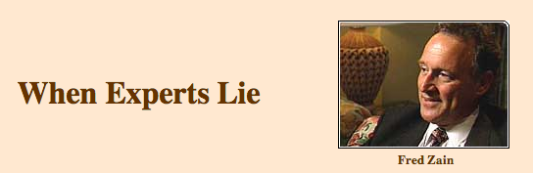
West Virginia State Police forensics expert who testified in hundreds of criminal cases
Very persuasive in court
…became something of a forensics "star," sought after by prosecutors who wanted to win convictions in difficult cases

Slide 20
Lies
Falsified his own credentials
Fabricated and altered evidence
Convicted an innocent man of sex crimes in 1997
  He was freed when DNA evidence proved he was innocent
  Sued State of West VA
  That exposed Fred Zain
Real rapist was caught 24 years later

Slide 21
Tool Validation
Each tool, software or hardware, must be tested before use on an actual case
Paper records are necessary to prove this

Slide 22
Documentation
Case File
  Case submission forms
  Requests for assistance
  Chain of custody reports
  Examiner's notes
  Crime scene reports
  Examiner's final reports
  Copy of search authorizatity
  All collected in a case file
Preprinted forms help maintain uniformity

Slide 23
Examiner Notes
Must be detailed enough to enable another examiner to duplicate the process
  Discussions with key players including prosecutors and investigators
  Irregularities found and actions taken
  OS versions & patches
  Passwords
  Changes made to the system by lab personnel and law enforcement
It may be years before trial, and you will need to understand your notes

Slide 24
Examiner's Final Report
Formal document delivered to prosecutors. investigators, opposing counsel, etc.
Remember the audience is nontechnical
Avoid jargon, acronyms, and unnecessary details

Slide 25
Examiner's Final Report Contents
Identity of the reporting agency
Case ID #
Identity of the submitting person and case investigator
Dates of receipt and report
Detailed description of the evidence items submitted
  Serial numbers, makes, models, etc.
Identity of the examiner
Description of the steps taken during the examination process
Results and conclusions

Slide 26
Examiner's Final Report Sections
Summary
  Brief description of the results
Detailed findings
  Files pertaining to the request
  Files that support the findings
  Email, Web cache, chat logs, etc.
  Keyword searches
  Evidence of ownership of the device
Glossary

Slide 27
Digital Forensic Tools

Slide 28
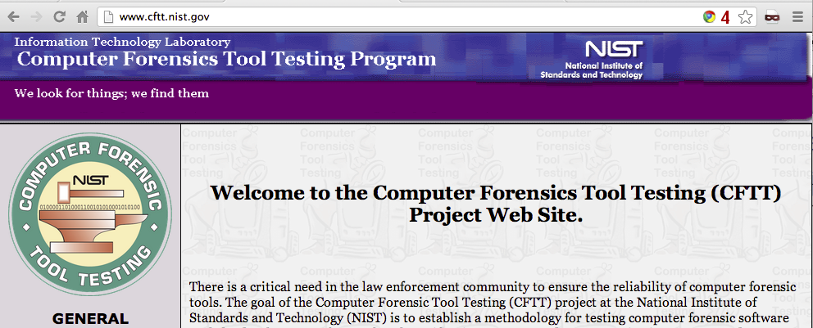
Digital Forensic Tools
NIST's Forensic Tool Testing Project

Slide 29
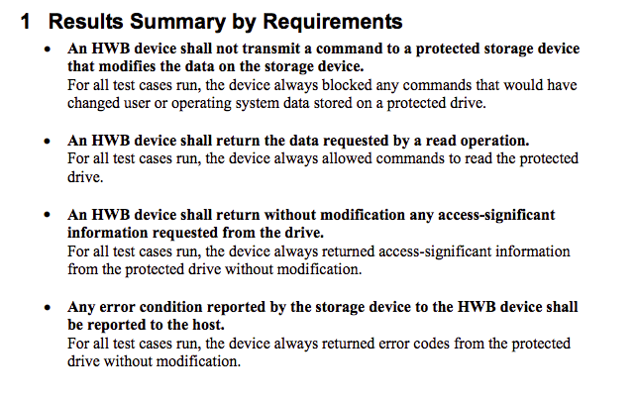
Sample Report

Slide 30
Hardware Tools
Cloning devices
Cell phone acquisition devices
Write blockers
Portable storage devices
Adapters
Cables
Much more

Slide 31
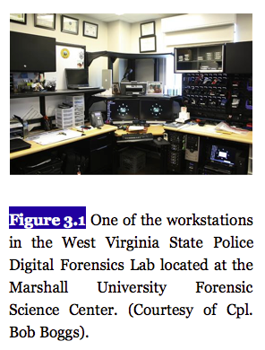
From textbook

Slide 32
Computer Recommendations
Multiple multicore processors
As much RAM as possible
Large, fast hard drives
FTK 4 recommends:
  64-bit processor, Quad core
  8 GB RAM
  A dedicated 150 GB hard disk for the PostgreSQL database; SSD or RAID preferred
  1 GB network

Slide 33
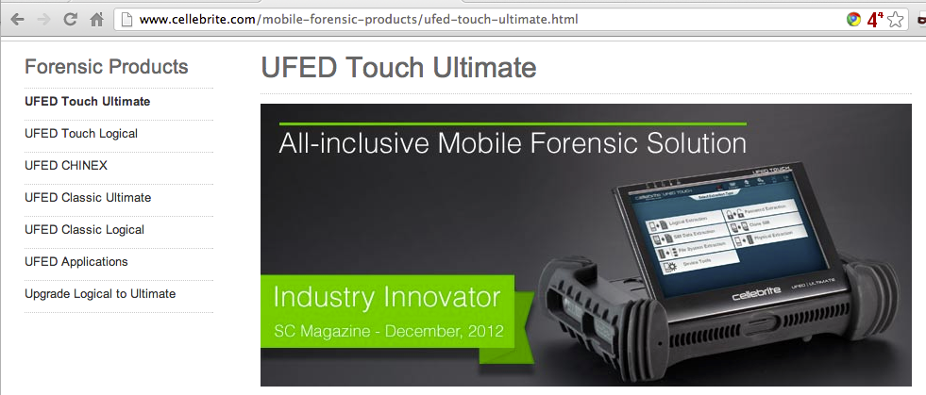
Non-PC Hardware
Cellebrite's UFED
  Supports over 3,000 phones

Slide 34
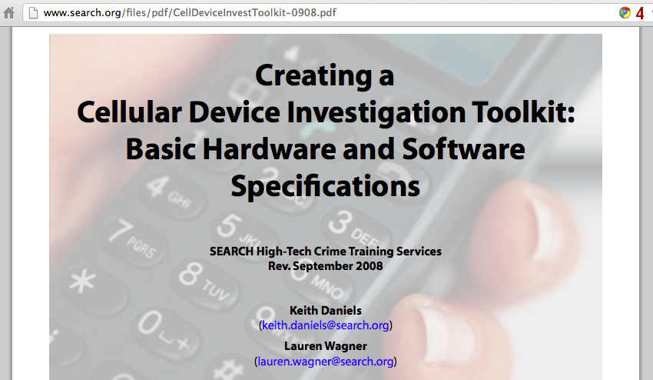

Slide 35
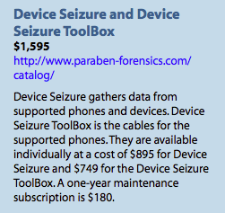
Paraben
Competes with Cellebrite
Supports more than 4,000 phones, PDAs, and GPS units

Slide 36
Cloners and Kits
Hardware Cloners
  Faster, can clone multiple drives at once
  Provide write protection, hash authentication, drive wiping, audit trail…
Crime scene kits
  Preloaded with supplies to collect digital evidence
  Pens, digital camera, forensically clean storage media, evidence bags, evidence tape, report forms, markers…

Slide 37
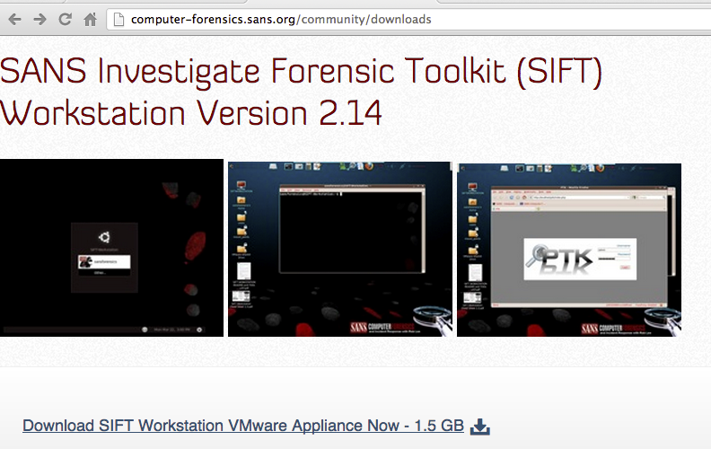
Software: Open-Source
SIFT: SANS Investigative Forensic Toolkit
SIFT Workstation is free, based on Ubuntu

Slide 38
SIFT Capabilities
File carving
Analyzing file systems
Web history
Recycle bin
Memory
Timeline
Windows (MSDOS FAT, VFAT, NTFS)
Mac (HFS)
Solaris (USF)
Linux (ext2/3/4)

Slide 39
SIFT Capabilities
Evidence Image Support
  Expert Witness (E01)
  RAW (dd)
  Advanced Forensic Format (AFF)

Slide 40
SIFT Capabilities
The Sleuth Kit (File system Analysis Tools)
log2timeline (Timeline Generation Tool)
ssdeep & md5deep (Hashing Tools)
Foremost/Scalpel (File Carving)
WireShark (Network Forensics)
Vinetto (thumbs.db examination)
Pasco (IE Web History examination)
Rifiuti (Recycle Bin examination)
Volatility Framework (Memory Analysis)
DFLabs PTK (GUI Front-End for Sleuthkit)
Autopsy (GUI Front-End for Sleuthkit)
PyFLAG (GUI Log/Disk Examination)

Slide 41
Commercial Tools
EnCase & FTK have similar capabilities
  Searching
  E-mail ananysis
  Sorting
  Reporting
  Password cracking

Slide 42
EnCase & FTK
Search tools
  E-mail addresses
  Names
  Phone numbers
  Keywords
  Web addresses
  File types
  Date ranges

Slide 43
Don't Trust Tools
Using a tool without understanding what it's doing is a trap
Verify all findings with a second tool, like a simple hex editor
You must figure out how the data got on the system and what it means

Slide 44
Other Multipurpose Tools
Acquisition, verification, searching, reporting, wiping, etc.)
  SMART
  ProDiscover
  X-Ways Forensics
  Helix (Linux-based)
  Raptor (Linux-based)

Slide 45
Other Tools
Mac Tools
  Softblock
  Macquisition
  Blacklight
  BlackBag
  Mac Marshall

Slide 46
Other Tools
Dossier from LogiCube
  Hardware acquisition
Tableau
  Write-blockers
Weibetech
  Write-blockers

Slide 47
Accreditation v. Certification

Slide 48
Accreditation
Endorsement of a crime lab's policies and procedures
  ASCLD/LAB does this
    Very burdensome to achieve
    Not possible for every lab
  ASTM also accredits labs

Slide 49
Certification
Applies to examiners, not the lab
  SWGDE Core Competencies for Forensic Practitioner Certification
    Pre-examination procedures and legal issues
    Media assessment and analysis
    Data recovery
    Specific analysis of recovered data
    Documentation and reporting
    Presentation of findings

Slide 50
Q&A
http://fpt.edu.vn

